Slide 1


http://www.comp.nus.edu.sg/~cs2100/
Lecture #3c
Data Representation and Number Systems

Slide 2
Questions?
Ask at https://sets.netlify.app/module/66988ae3322ba68d1103fdd4
OR
Scan and ask your questions here! (May be obscured in some slides)

Slide 3
10.6 2s Complement on Addition/Subtraction (1/4)
Algorithm for addition of integers, A + B:
Perform binary addition on the two numbers.
Ignore the carry out of the MSB.
Check for overflow. Overflow occurs if the ‘carry in’ and ‘carry out’ of the MSB are different, or if result is opposite sign of A and B.
Algorithm for subtraction of integers, A – B: A – B = A + (-B)
Take 2s-complement of B.
Add the 2s-complement of B to A.

Slide 4
10.6 Overflow (2/4)
Signed numbers are of a fixed range.
If the result of addition/subtraction goes beyond this range, an overflow occurs.
Overflow can be easily detected:
positive add positive → negative
negative add negative → positive
Example: 4-bit 2s-complement system
Range of value: -8₁₀ to 7₁₀
0101_{2s} + 0110_{2s} = 1011_{2s} 5₁₀ + 6₁₀ = -5₁₀ ?! (overflow!)
1001_{2s} + 1101_{2s} = 10110_{2s} (discard end-carry) = 0110_{2s} -7₁₀ + -3₁₀ = 6₁₀ ?! (overflow!)

Slide 5
10.6 2s Complement Addition (3/4)
Examples: 4-bit system
+3 0011
+ +4 + 0100
---- -------
+7 0111
---- -------
-2 1110
+ -6 + 1010
---- -------
-8 11000
---- -------
No overflow
No overflow
+6 0110
+ -3 + 1101
---- -------
+3 10011
---- -------
+4 0100
+ -7 + 1001
---- -------
-3 1101
---- -------
No overflow
No overflow
-3 1101
+ -6 + 1010
---- -------
-9 10111
---- -------
+5 0101
+ +6 + 0110
---- -------
+11 1011
---- -------
Overflow!
Overflow!
Which of the above is/are overflow(s)?

Slide 6
10.6 2s Complement Subtraction (4/4)
Examples: 4-bit system
4 – 7
Convert it to 4 + (-7)
+4 0100
+ -7 + 1001
---- -------
-3 1101
---- -------
No overflow
6 – 1
Convert it to 6 + (-1)
+6 0110
+ -1 + 1111
---- -------
+5 10101
---- -------
No overflow
-5 – 4
Convert it to -5 + (-4)
-5 1011
+ -4 + 1100
---- -------
-9 10111
---- -------
Overflow!
Which of the above is/are overflow(s)?

Slide 7
10.7 1s Complement on Addition/Subtraction (1/2)
Algorithm for addition of integers, A + B:
Perform binary addition on the two numbers.
If there is a carry out of the MSB, add 1 to the result.
Check for overflow. Overflow occurs if result is opposite sign of A and B.
Algorithm for subtraction of integers, A – B: A – B = A + (-B)
Take 1s-complement of B.
Add the 1s-complement of B to A.

Slide 8
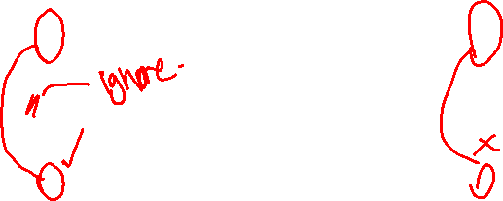
10.7 1s Complement Addition (2/2)
Examples: 4-bit system
+3 0011
+ +4 + 0100
---- -------
+7 0111
---- -------
+5 0101
+ -5 + 1010
---- -------
-0 1111
---- -------
No overflow
No overflow
-2 1101
+ -5 + 1010
---- -------
-7 10111
---- + 1
-------
1000
-------
-3 1100
+ -7 + 1000
---- -------
-10 10100
---- + 1
-------
0101
-------
No overflow
Overflow!
Any overflow?
DLD page 42 – 43 Quick Review Questions Questions 2-13 to 2-18.

Slide 9
10.8 Excess Representation (1/2)
Besides sign-and-magnitude and complement schemes, the excess representation is another scheme.
It allows the range of values to be distributed evenly between the positive and negative values, by a simple translation (addition/subtraction).
Example: Excess-4 representation on 3-bit numbers. See table on the right.
Excess-4 Representation | Value
000 | -4
001 | -3
010 | -2
011 | -1
100 | 0
101 | 1
110 | 2
111 | 3
Questions: What if we use Excess-2 on 3-bit numbers? Or Excess-7?

Slide 10
10.8 Excess Representation (2/2)
Example: For 4-bit numbers, we may use excess-7 or excess-8. Excess-8 is shown below.
Excess-8 Representation | Value
0000 | -8
0001 | -7
0010 | -6
0011 | -5
0100 | -4
0101 | -3
0110 | -2
0111 | -1
Excess-8 Representation | Value
1000 | 0
1001 | 1
1010 | 2
1011 | 3
1100 | 4
1101 | 5
1110 | 6
1111 | 7

Slide 11
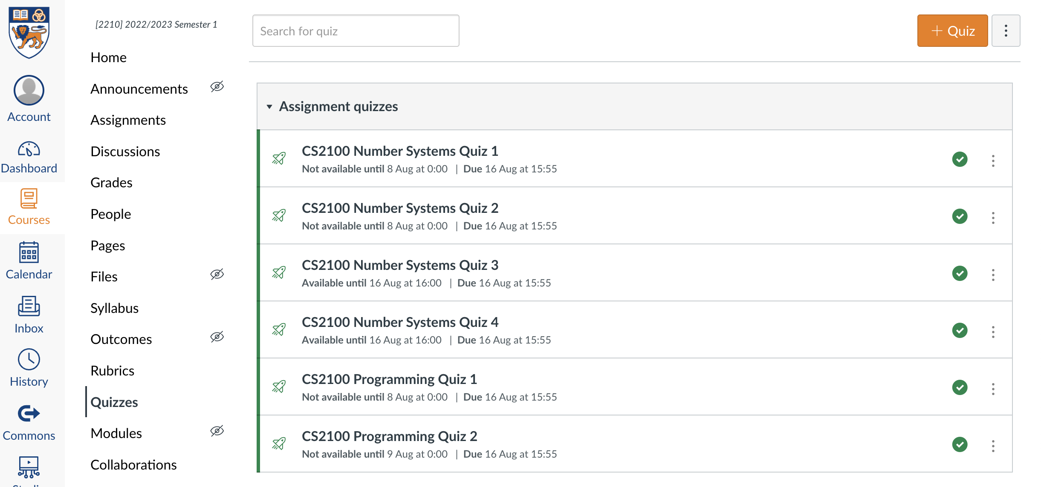
Quiz
Please complete the “CS2100 C Number Systems Quiz 3” in Canvas.
Access via the “Quizzes” tool in the left toolbar and select the quiz on the right side of the screen.

Slide 12
End of File

